Slide 1
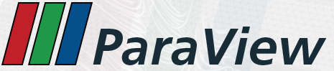
Introduction a Paraview

Slide 2
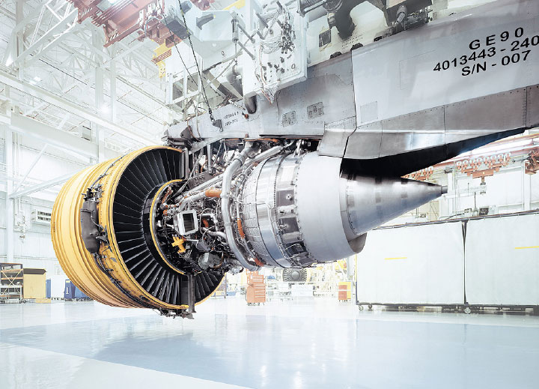
Outline
Introduction
Basic Usage
Scripting
Visualizing Large Models

Slide 3
To Follow Along…
Install ParaView 5.2.
  http://www.paraview.org → Download
Get example material.
  http://www.paraview.org/Wiki/The_ParaView_Tutorial

Slide 4
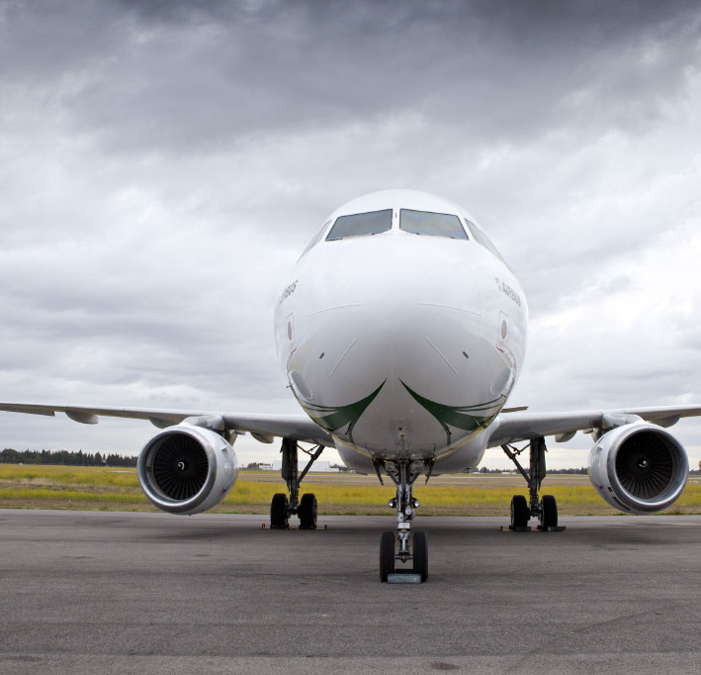
1
Introduction

Slide 5
What is ParaView?
An open-source, scalable, multi-platform visualization application.
Support for distributed computation models to process large data sets.
An open, flexible, and intuitive user interface.
An extensible, modular architecture based on open standards.
A flexible BSD 3 Clause license
Commercial maintenance and support.

Slide 6
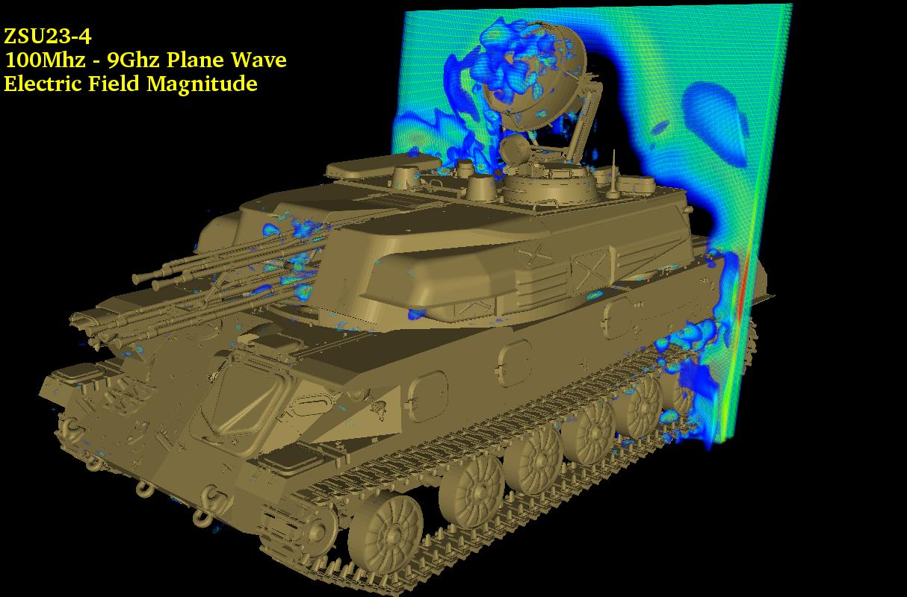
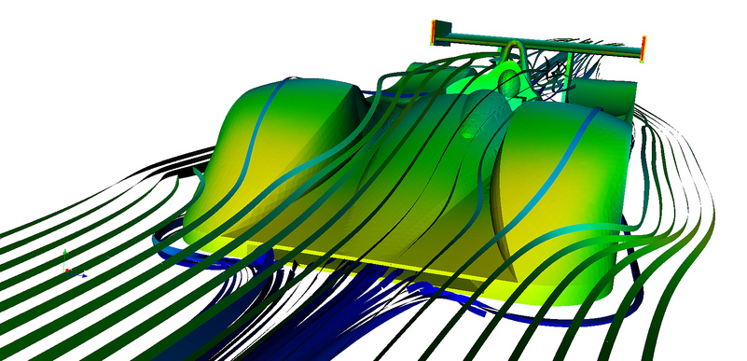
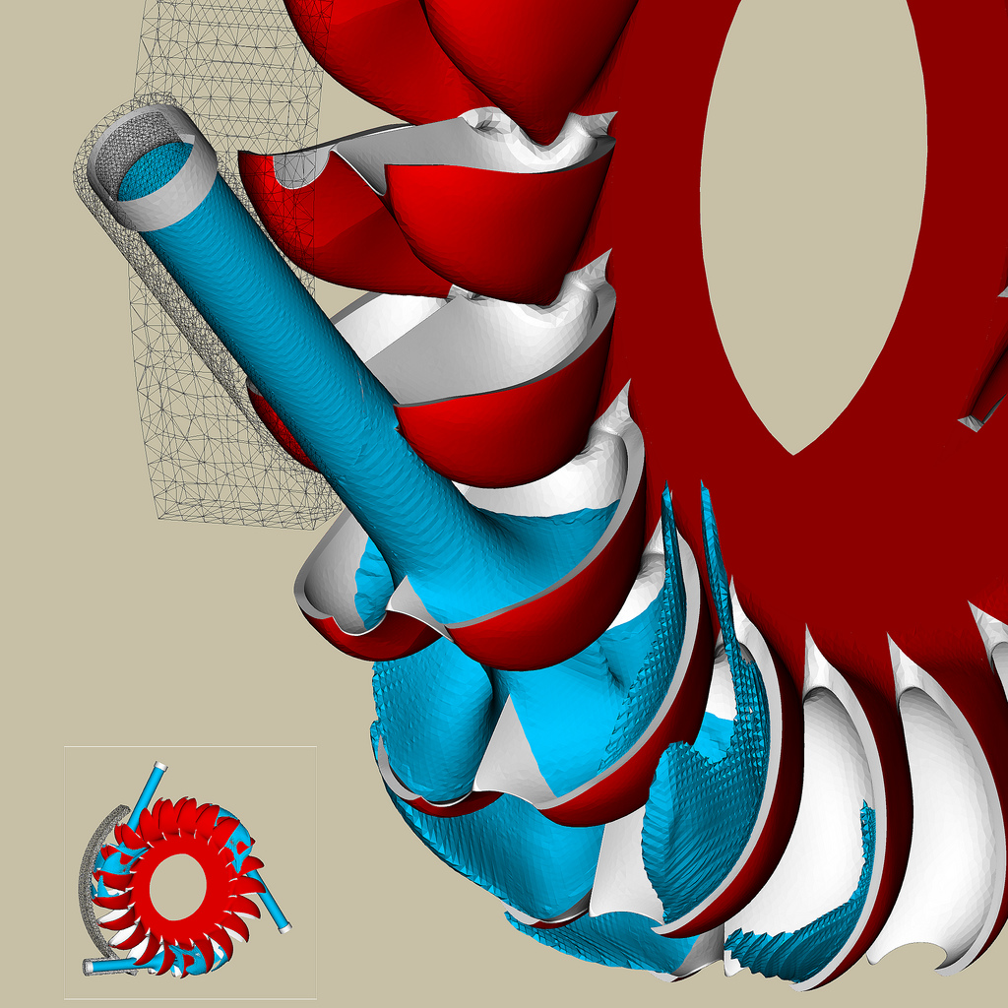
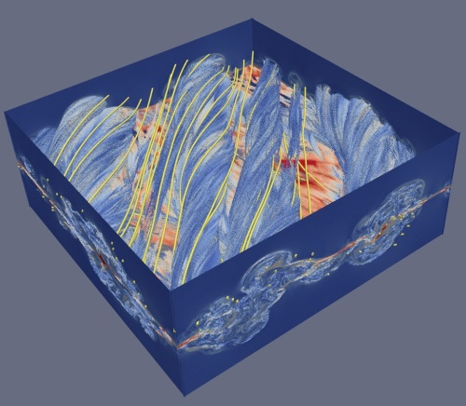
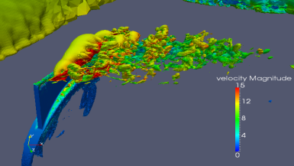
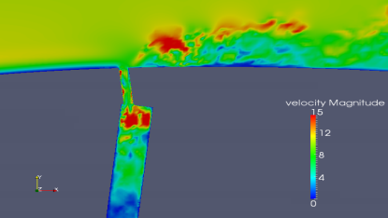
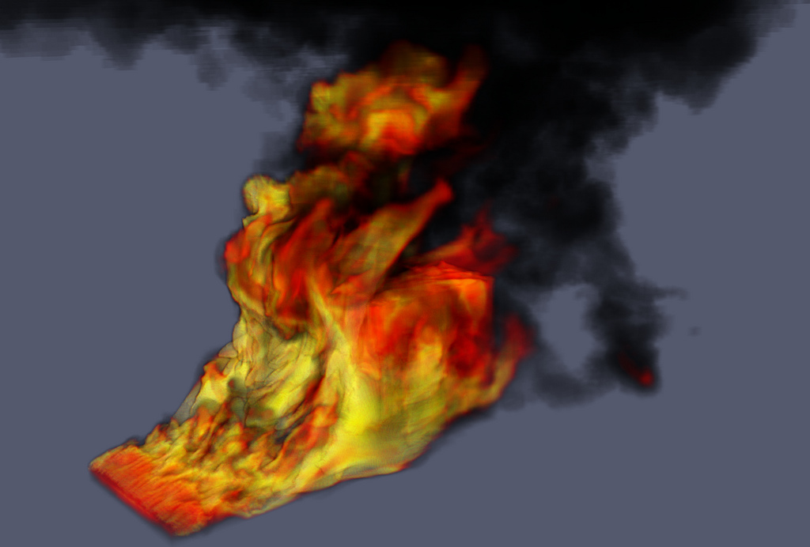
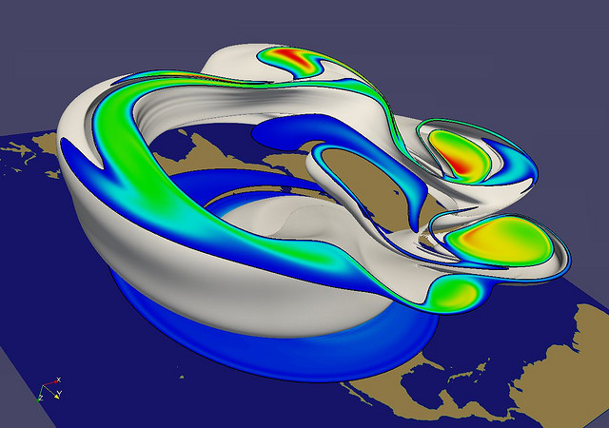
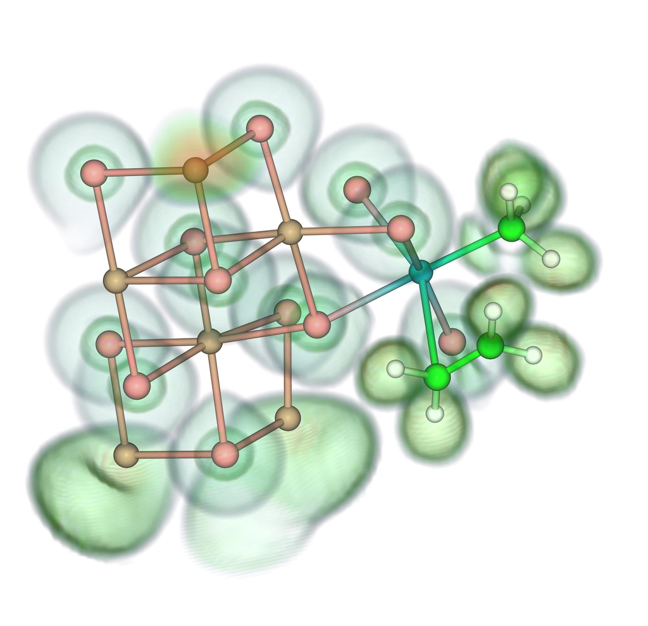
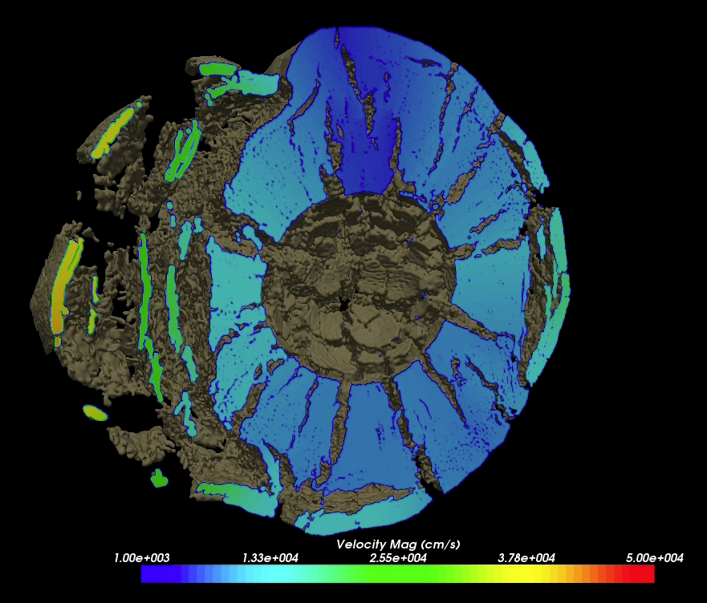
Renato N. Elias, NACAD/COPPE/UFRJ, Rio de Janerio, Brazil
Jerry Clarke, US Army Research Laboratory
Swiss National Supercomputing Centre
Bill Daughton, LANL
Swiss National Supercomputing Centre
Notes:
Small montage of projects using ParaView.
Demonstrates the breadth of utility ParaView has.

Slide 7
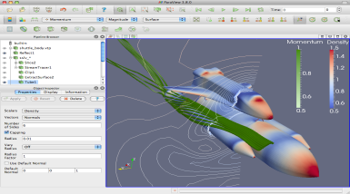
ParaView Application Architecture
ParaView Client
pvpython
ParaWeb
Catalyst
Custom App
UI (Qt Widgets, Python Wrappings)
ParaView Server
VTK
OpenGL
MPI
IceT
Etc.

Slide 8
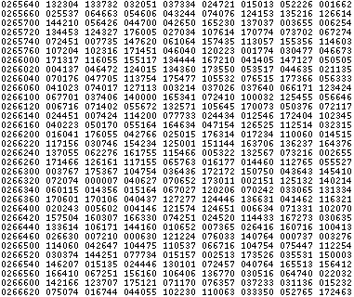
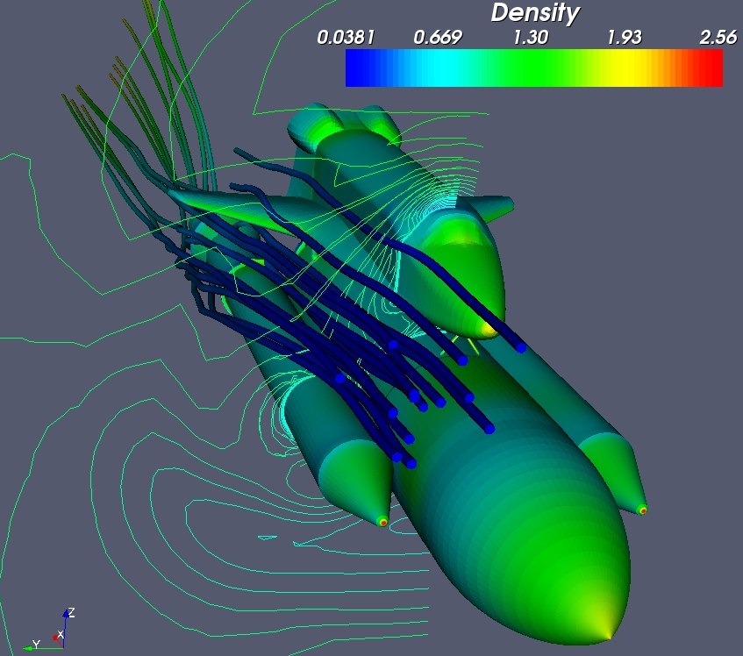
Basics of Visualization

Slide 9
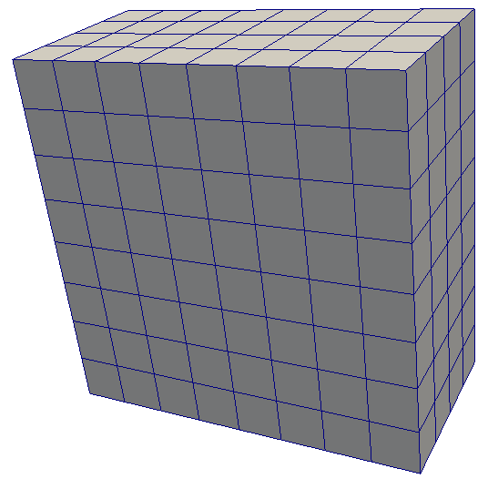
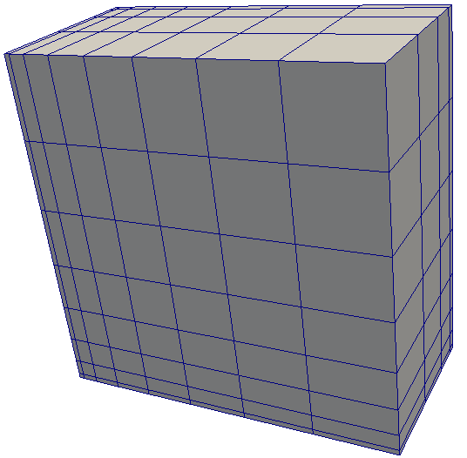
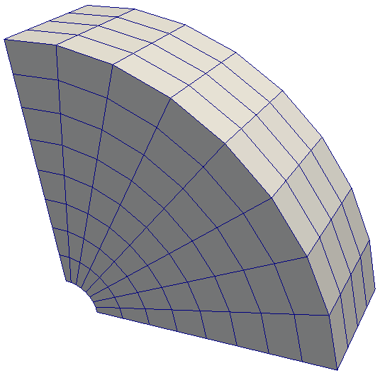
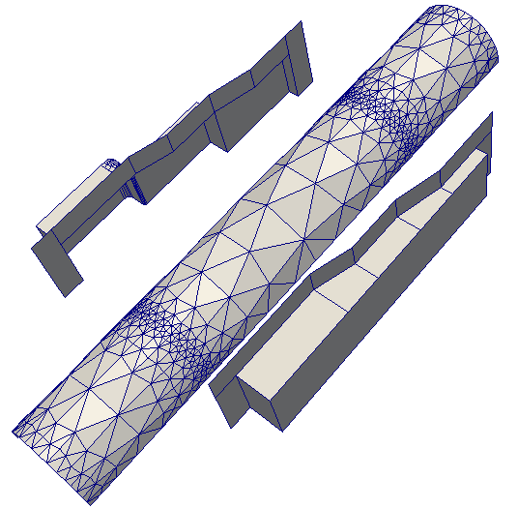
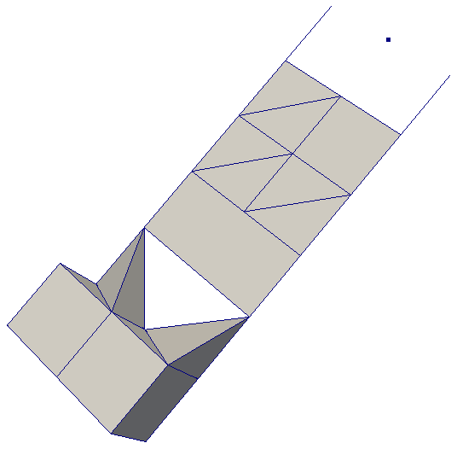
Data Types
Uniform Rectilinear
(vtkImageData)
Non-Uniform Rectilinear
(vtkRectilinearData)
Curvilinear
(vtkStructuredData)
Multi-block
Hierarchical Adaptive Mesh Refinement (AMR)
Hierarchical Uniform AMR
Octree
Polygonal
(vtkPolyData)
Unstructured Grid
(vtkUnstructuredGrid)

Slide 10
2
Basic Usage

Slide 11
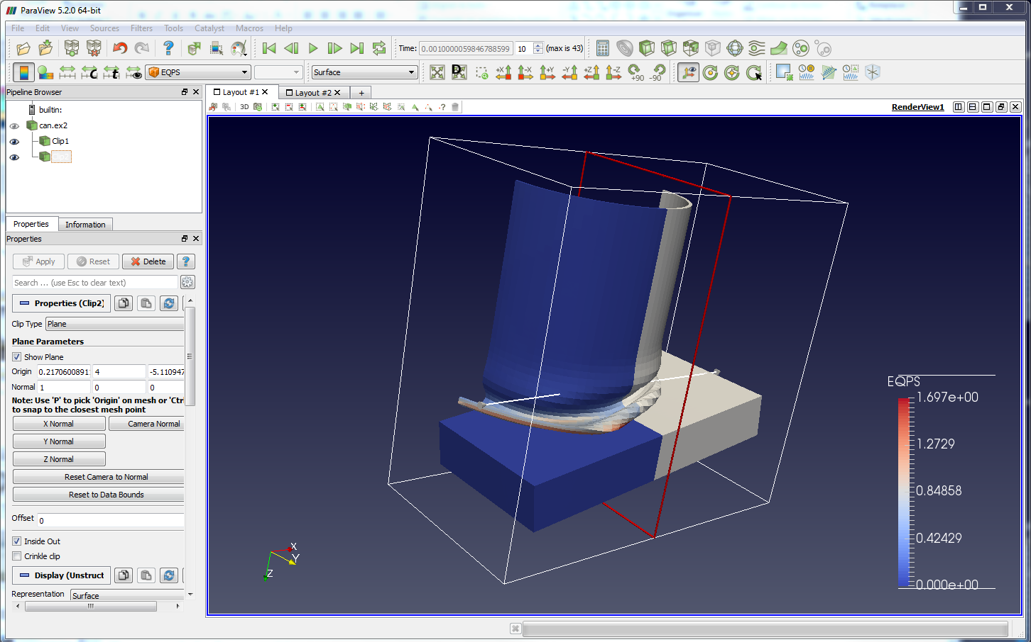
Menu Bar
Toolbars
Pipeline Browser
Properties Panel
Advanced Toggle
3D View

Slide 12
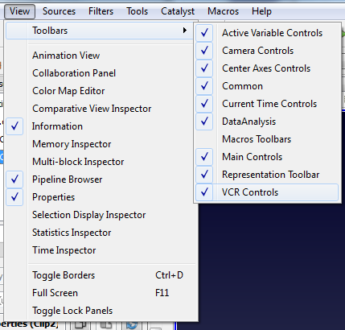
Getting Back GUI Components

Slide 13

Creating a Cylinder Source
Go to the “Source” menu and select ”Cylinder”.
Click the “Apply” button to accept the default parameters.
You can active the “Apply changes to parameters automatically”

Slide 14


Simple Camera Manipulation
Drag left, middle, right buttons for rotate, pan, zoom.
  Also use Shift, Ctrl, Alt modifiers.

Slide 15
Creating a Cylinder Source
Go to the “Source” menu and select ”Cylinder”.
Click the “Apply” button to accept the default parameters.
Or
You can active the “Apply changes to parameters automatically”
Increase the Resolution parameter.
Click the button again.

Slide 16
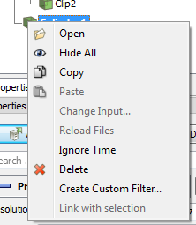
Pipeline Object Controls

Slide 17
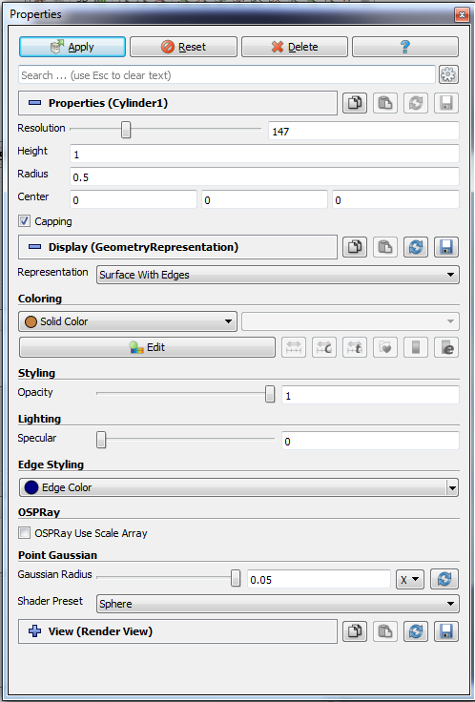
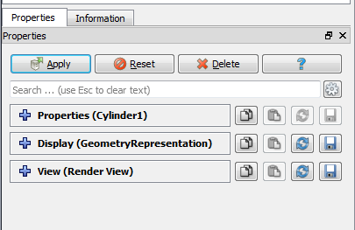
Display Properties

Slide 18
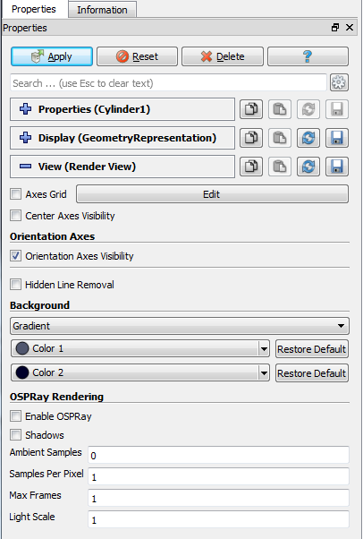
Render Properties

Slide 19




Undo Redo
Undo
Redo
Camera
Undo
Camera
Redo
Adjust
Camera

Slide 20
Creating a Cylinder Source
Go to the “Source” menu and select ”Cylinder”.
Click the “Apply” button to accept the default parameters.
Or
You can active the “Apply changes to parameters automatically”
Increase the Resolution parameter.
Click the button again.
Delete the Cylinder.

Slide 21
Supported Data Types
ParaView Data (.pvd)
VTK (.vtp, .vtu, .vti, .vts, .vtr)
VTK Legacy (.vtk)
VTK Multi Block (.vtm,.vtmb,.vtmg,.vthd,.vthb)
Partitioned VTK (.pvtu, .pvti, .pvts, .pvtr)
ADAPT (.nc, .cdf, .elev, .ncd)
ANALYZE (.img, .hdr)
ANSYS (.inp)
AVS UCD (.inp)
BOV (.bov)
BYU (.g)
CAM NetCDF (.nc, .ncdf)
CCSM MTSD (.nc, .cdf, .elev, .ncd)
CCSM STSD (.nc, .cdf, .elev, .ncd)
CEAucd (.ucd, .inp)
CMAT (.cmat)
CML (.cml)
CTRL (.ctrl)
Chombo (.hdf5, .h5)
Claw (.claw)
Comma Separated Values (.csv)
Cosmology Files (.cosmo, .gadget2)
Curve2D (.curve, .ultra, .ult, .u)
DDCMD (.ddcmd)
Digital Elevation Map (.dem)
Dyna3D(.dyn)
EnSight (.case, .sos)
Enzo boundary and hierarchy
ExodusII (.g, .e, .exe, .ex2, .ex2v.., etc)
ExtrudedVol (.exvol)
FVCOM (MTMD, MTSD, Particle, STSD)
Facet Polygonal Data
Flash multiblock files
Fluent Case Files (.cas)
GGCM (.3df, .mer)
GTC (.h5)
GULP (.trg)
Gadget (.gadget)
Gaussian Cube File (.cube)
JPEG Image (.jpg, .jpeg)
LAMPPS Dump (.dump)
LAMPPS Structure Files
LODI (.nc, .cdf, .elev, .ncd)
LODI Particle (.nc, .cdf, .elev, .ncd)
LS-DYNA (.k, .lsdyna, .d3plot, d3plot)
M3DCl (.h5)
MFIX Unstructred Grid (.RES)
MM5 (.mm5)
MPAS NetCDF (.nc, .ncdf)
Meta Image (.mhd, .mha)
Miranda (.mir, .raw)
Multilevel 3d Plasma (.m3d, .h5)
NASTRAN (.nas, .f06)
Nek5000 Files
Nrrd Raw Image (.nrrd, .nhdr)
OpenFOAM Files (.foam)
PATRAN (.neu)
PFLOTRAN (.h5)
PLOT2D (.p2d)
PLOT3D (.xyz, .q, .x, .vp3d)
PLY Polygonal File Format
PNG Image Files
POP Ocean Files
ParaDIS Files
Phasta Files (.pht)
Pixie Files (.h5)
ProSTAR (.cel, .vrt)
Protein Data Bank (.pdb, .ent, .pdb)
Raw Image Files
Raw NRRD image files (.nrrd)
SAMRAI (.samrai)
SAR (.SAR, .sar)
SAS (.sasgeom, .sas, .sasdata)
SESAME Tables
SLAC netCDF mesh and mode data
SLAC netCDF particle data
Silo (.silo, .pdb)
Spheral (.spheral, .sv)
SpyPlot CTH
SpyPlot (.case)
SpyPlot History (.hscth)
Stereo Lithography (.stl)
TFT Files
TIFF Image Files
TSurf Files
Tecplot ASCII (.tec, .tp)
Tecplot Binary (.plt)
Tetrad (.hdf5, .h5)
UNIC (.h5)
VASP CHGCA (.CHG)
VASP OUT (.OUT)
VASP POSTCAR (.POS)
VPIC (.vpc)
VRML (.wrl)
Velodyne (.vld, .rst)
VizSchema (.h5, .vsh5)
Wavefront Polygonal Data (.obj)
WindBlade (.wind)
XDMF and hdf5 (.xmf, .xdmf)
XMol Molecule

Slide 22
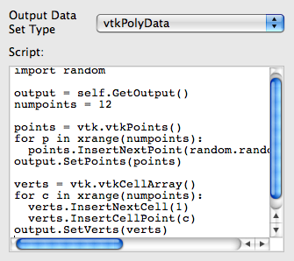
Custom Data Import:
Prototype with Python
A “programmable source” lets you program data readers right in the GUI.
Uses wrappings for the basic VTK classes.
Good for prototyping readers.
Can be used also to export data to a custom file format

Slide 23
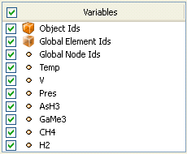
Load disk_out_ref.ex2
Open the file disk_out_ref.ex2.
Load all data variables.
Click

Slide 24
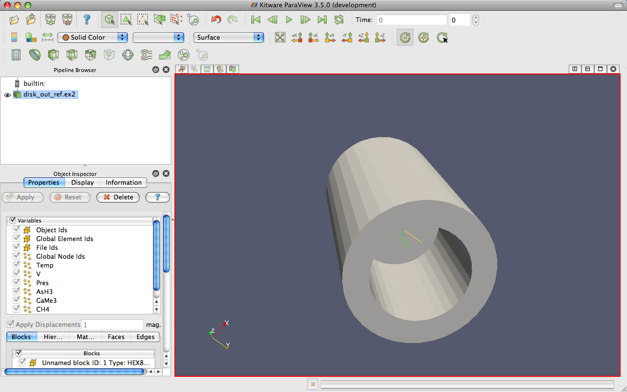
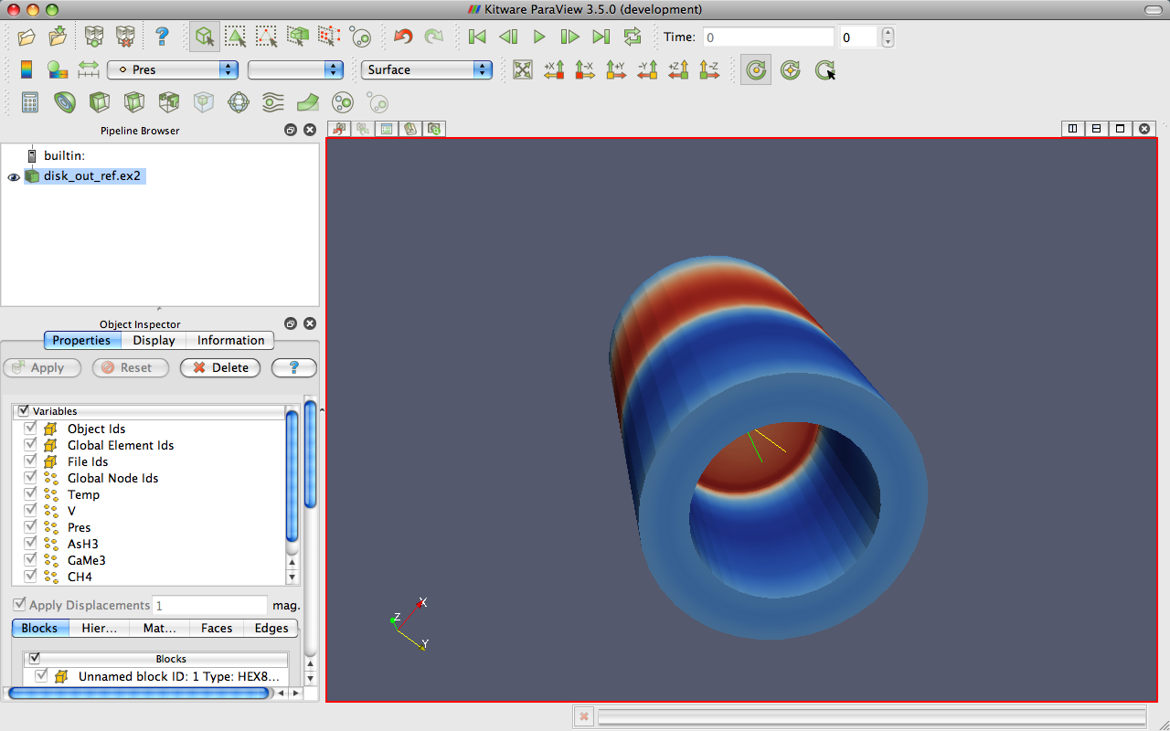
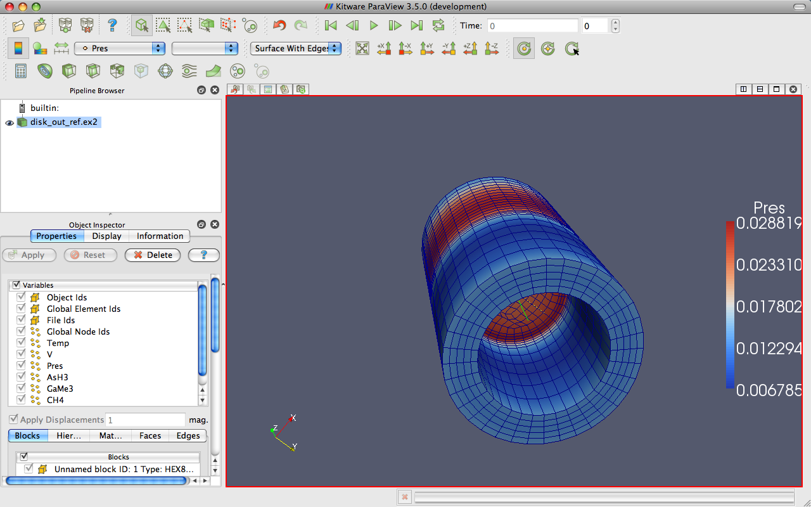
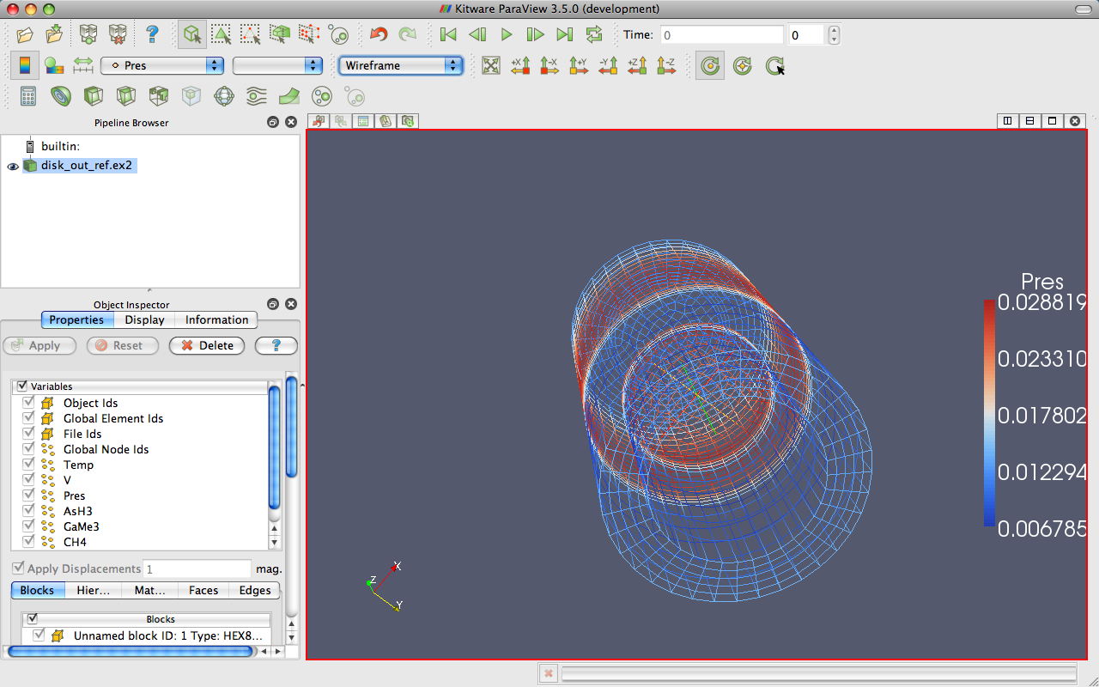
Data Representation
T
oggle Color
Reset Scalar
Mapped
V
ector
Legend
Range
Variable
Component
Representation
Edit
Custom Scalar
Colors
Range
Notes:
Also do volume rendering.

Slide 25
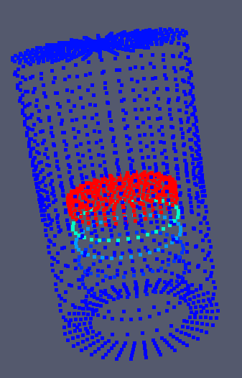
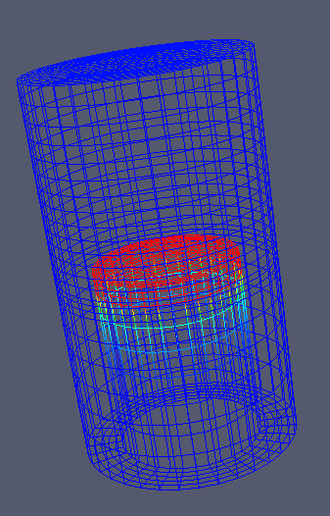
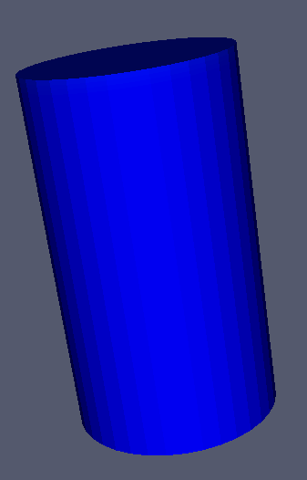
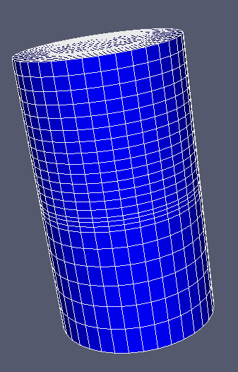
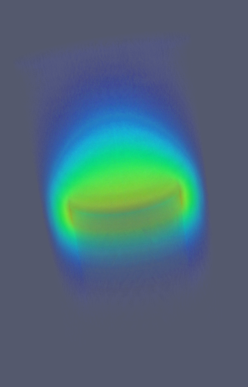
Geometry Representations
Points
Wireframe
Surface
Surface
with Edges
Volume

Slide 26











Common Filters
Calculator
Contour
Clip
Slice
Threshold
Extract Subset
Glyph
Stream Tracer
Warp (vector)
Group Datasets
Extract Level

Slide 27
Apply a Filter
Make sure that disk_out_ref.ex2 is selected in the pipeline browser.
Select the contour filter.

Slide 28
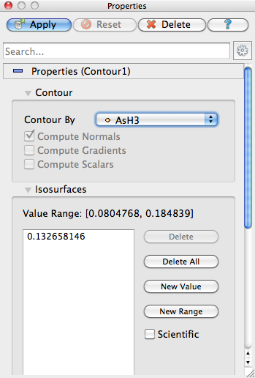
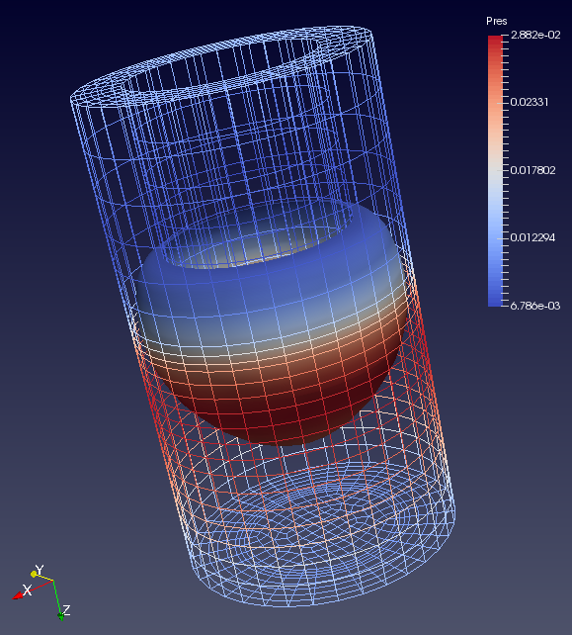
Apply a Filter
Change parameters to create an isosurface at Temp = 400K.
Change to Temp
Change to 400

Slide 29
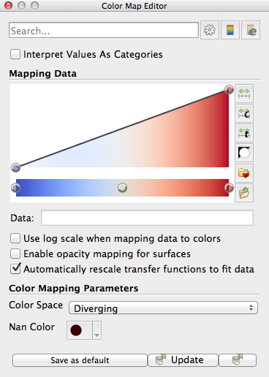
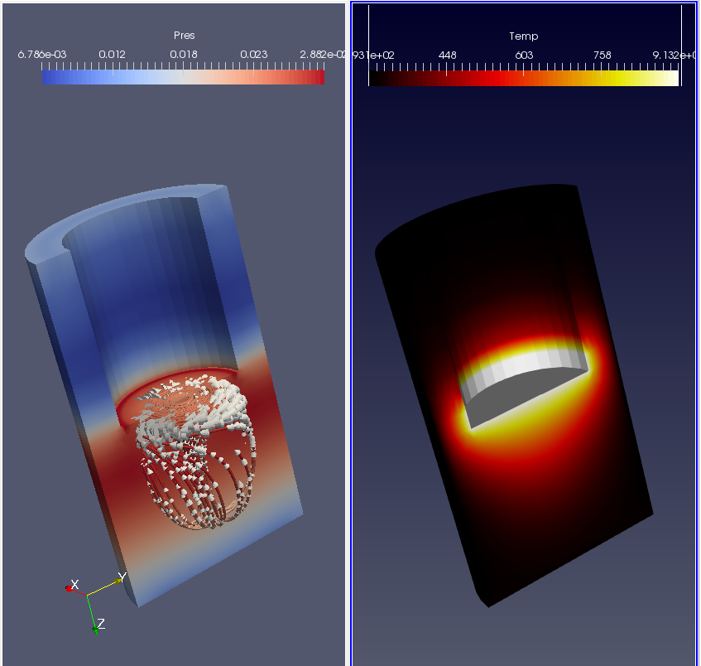

Transfer Function Editor
Transfer function and range are global properties of fields
Notes:
Add control points by clicking in color box.
Drag control points to move them.
Delete active point by hitting backspace or delete.
Click active point to change its color.
Can save and load transfer functions.
Load black-body radiation.

Slide 30
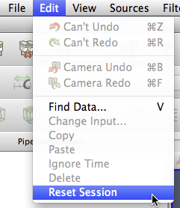
Reset ParaView
Edit → Reset Session

Slide 31
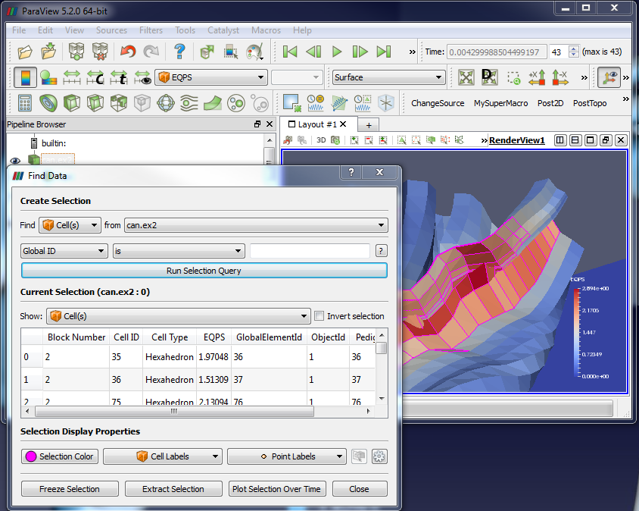

Query-Based Selection
Open can.ex2. All variables.
Go to last time step.
Edit → Find Data.
Or “V” key
Top combo box: find Cells.
Next row: EQPS, is >=, and 1.5.
Click Run Selection Query.

Slide 32
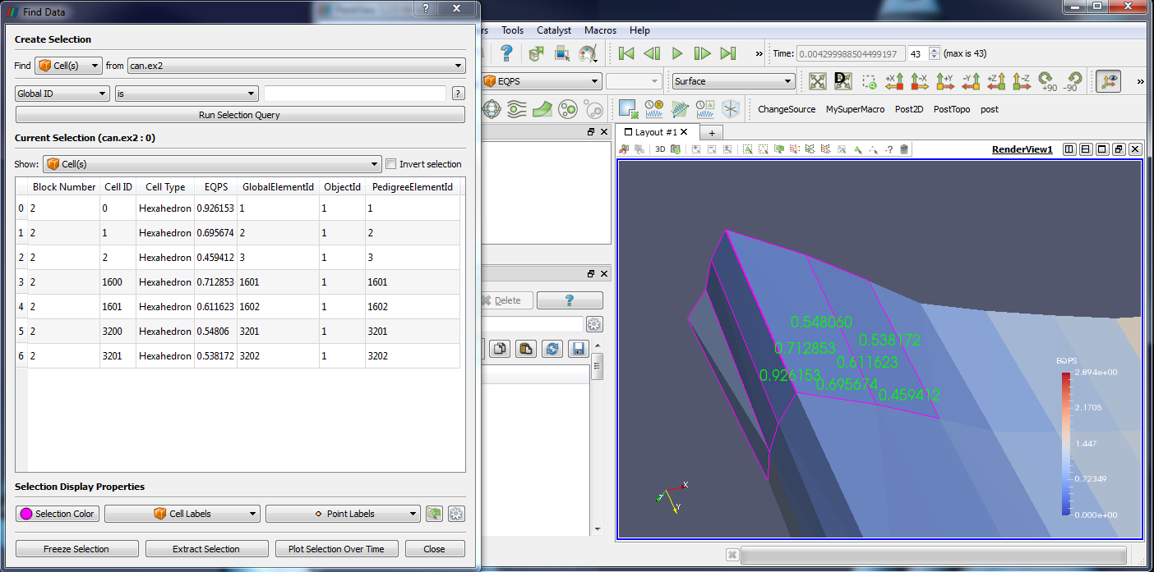




Brush Selection
Surface Cell Selection (shortcut: s)
Surface Point Selection
Through Cell Selection
Through Point Selection
Select Points (polygon)
Select Cells (polygon)
Block Selection (shortcut: b)
Shift = Subtract to current selection
Control = Add to current
Notes:
Rubber band selection tools and polygon selection tools which create polygon by dragging

Slide 33
Brush Selection

Slide 34
Save Screenshot/Animation
Choose “File” → Save Screenshot
Complete the following dialogs.
Turn on Cube Axes around can.
Chose File → Export Scene
Complete the following dialogs.
Chose File → Save Animation
Complete the following dialogs.

Slide 35
2
Scripting

Slide 36
Python Batch Scripting
Interpreter: Tools → Python Shell.
      External programs pvpython and pvbatch.
      Can add bindings to external interpreters.
Run Python scripts or bind to macros.
Can trace actions or capture state.
(Batch scripting is a different set of bindings than programmable sources/filters.)

Slide 37
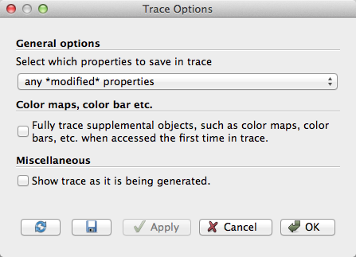
Tracing ParaView State
Select Tools → Start Trace.
Accept defaults (click OK).
Build a simple pipeline (e.g. create a
sphere source and clip it).
Select Tools → Stop Trace.
An editing window will open.

Slide 38
Adding a Macro
In Python edit window menu, select File → Save As Macro…
Chose a descriptive name. Save in directory provided.
Close Python edit window.
Select Edit → Reset Session.
Activate your macro (on toolbar or Macros menu).

Slide 39
4
Visualizing Large Models
(The Parallel size of Paraview)

Slide 40
ParaView Architecture
Standalone
Three tier
  Data Server
  Render Server
  Client
Client
Data
Server
Render
Server
Client-Server
Client-Render Server-Data Server
Data
Server
Render
Server
Data
Server
Render
Server
Client
Client

Slide 41
Requirements for
Installing ParaView Server
C++
CMake (www.cmake.org)
MPI
OpenGL (or Mesa3D www.mesa3d.org)
Qt 4.7 (optional)
Python +NumPy +Matplotlib (optional)
http://www.paraview.org/Wiki/Setting_up_a_ParaView_Server#Compiling

Slide 42
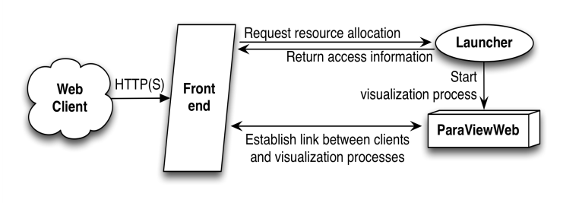
What’s That?
Web visualization framework (remote)
ParaView client on the web.

Slide 43


Slide 44
Why In Situ?
System Parameter | 2011 | “2018” |  | Factor Change
System peak | 2 PF | 1 EF |  | 500
Power | 6 MW | ≤20 MW |  | 3
System Memory | 0.3 PB | 32-64 PB |  | 33
Node Performance | 0.125 Tf/s | 1 TF | 10 TF | 8-80
Node Concurrency | 12 | 1,000 | 10,000 | 83-830
Network BW | 1.5 GB/s | 100 GB/s | 1,000 GB/s | 66-660
System Size (nodes) | 18,700 | 1M | 100k | 50
Total Concurrency | 225 K | 10 B | 100 B | 40k-400k
Storage Capacity | 15 PB | 300-1,000 PB |  | 20-67
I/O BW | 0.2 TB/s | 20-60 TB/s |  | 100-300
Source: “Scientific Discovery at the Exascale: Report from the DOE ASCR 2011 Workshop on Exascale Data Management, Analysis and Visualization.”
Notes:
Source Ken Moreland
HPC calculations produce complex datasets that are increasingly difficult to explore and understand using traditional post-processing workflows. To advance understanding of underlying physics, uncertainties, and results of HPC codes, SNL must gather as much relevant data as possible from large simulations. This drives SNL to couple data analysis and visualization capability with a running simulation, so that high fidelity data can be extracted and written to disk.

Slide 45
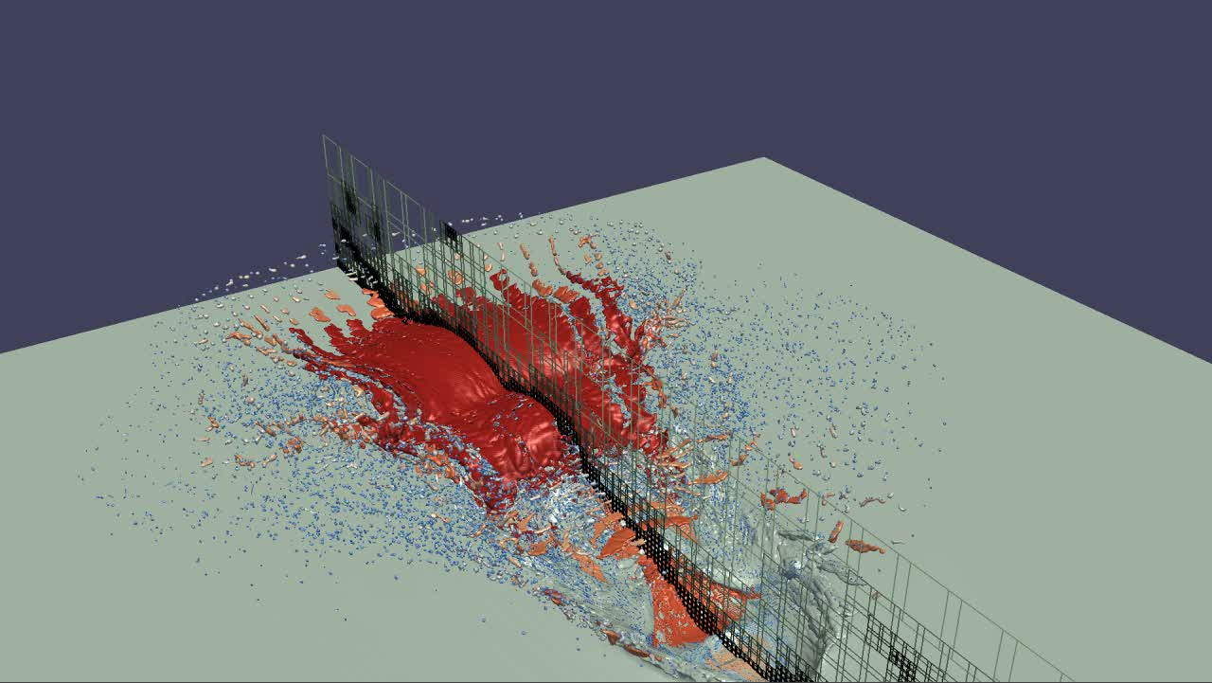
Traditional Vis
In Situ
Simulation
Simulation
ParaView Catalyst
Disk
Storage
ParaView
Results
Results
Notes:
Catalyst is a subset of pvserver meant to run with the simulation to prevent need for disk. It is small and fast so you can get more of and out of your data.
Storage is expensive, 1 sec to compute a timestep 10 minutes to save result during which all but a few of your thousands of nodes are idle
Transfering big saved data from sim cluster to vis cluster is even worse
So simulations arbitrarily throw out most of the data (ex keep only every thousandth timestep)
Key is to save extracts (visible surface data or images) all the time at minimal (in memory) cost
So, if you have to throw it out, at least throw it out smart

Slide 46
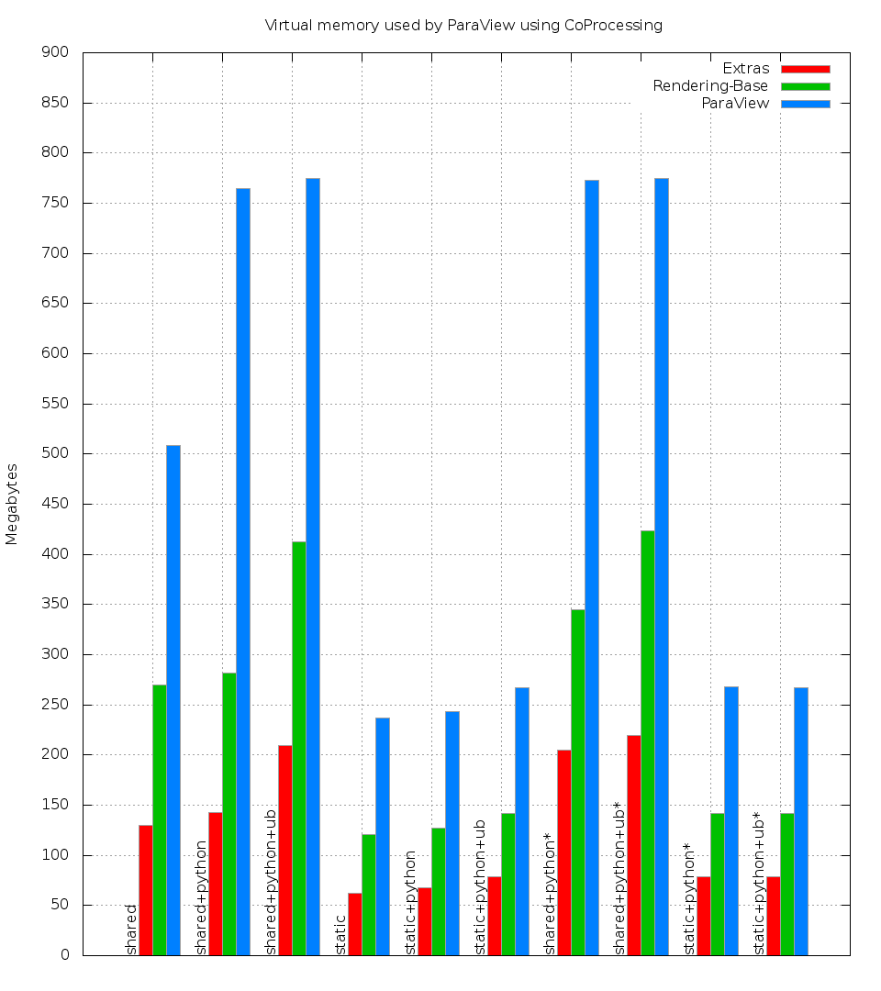
The Catalyst Diet http://www.kitware.com/blog/home/post/631
Scripts to generate subsets of ParaView
“Editions” - selected subsets of paraview
Base - bare minumum
+ essentials - writers
+ python - scripting
+ rendering

Slide 47
Exercise : Live Catalyst
> pvpython driver.py coprocessing-pipeline.py 500 &
> paraview &
Catalyst -> Connect …
Catalyst -> Set Break point …
Simulation
ParaView Catalyst
ParaView
Results

Slide 48
Want to Learn More?
Catalyst User’s Guide:
  http://paraview.org/Wiki/images/4/48/CatalystUsersGuide.pdf
Website:
  http://catalyst.paraview.org
Examples:
  https://github.com/acbauer/CatalystExampleCode
Notes:
Many of the paraview classes derive from VTK – can follow the inheritance hierarchy to get to VTK doxygen
http://paraview.org//Wiki for the main wiki page – also a paraview users guide there in pdf format

Slide 49
Thanks

